Slide 1
Interactive Social Network Visualization
Lu Han
Zilong Jiao
Zhi Xing

Slide 2
Outline
Accomplishments
Project workflow
Distributed crawlers
Communication channel
Cinder framework & our implementation
Physics simulation
Rendering
Conclusion

Slide 3
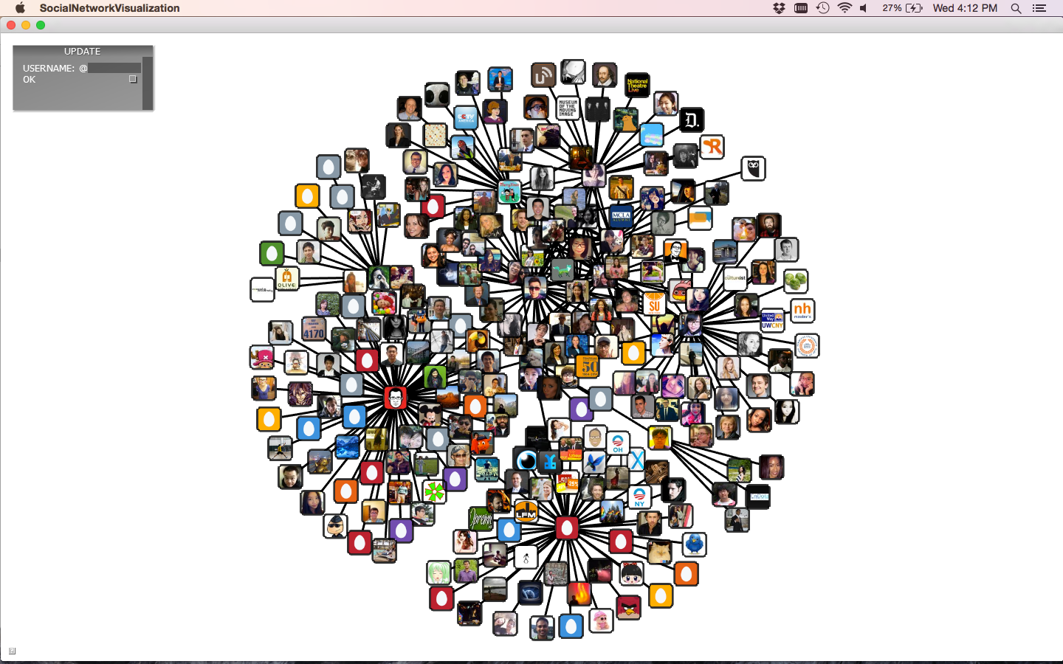

Slide 4
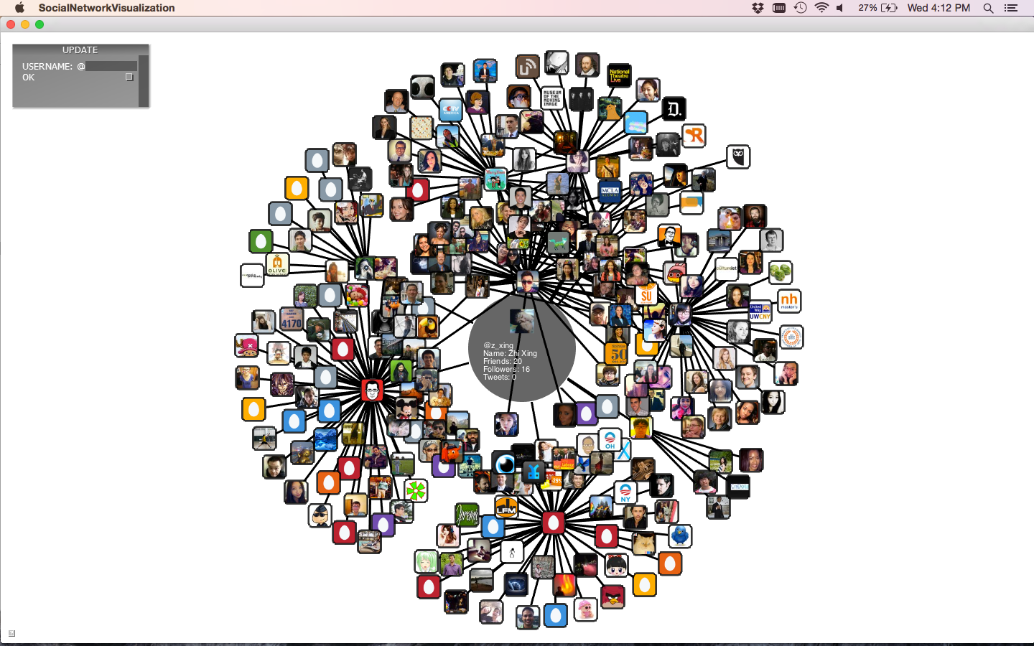

Slide 5
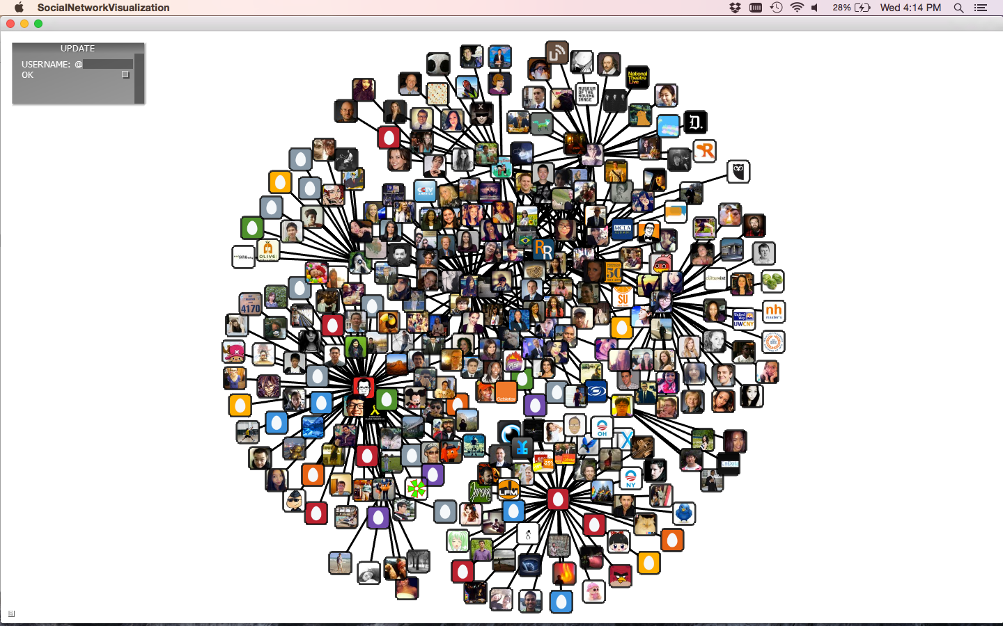

Slide 6
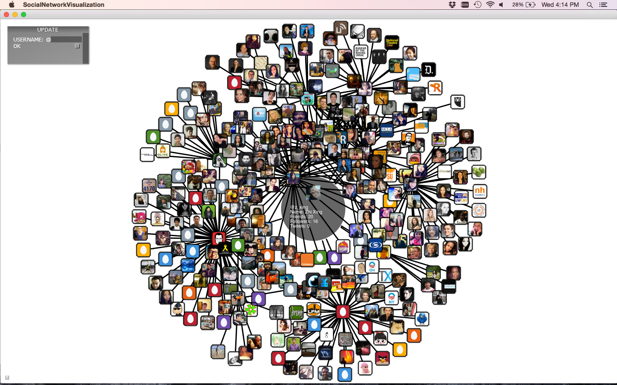

Slide 7
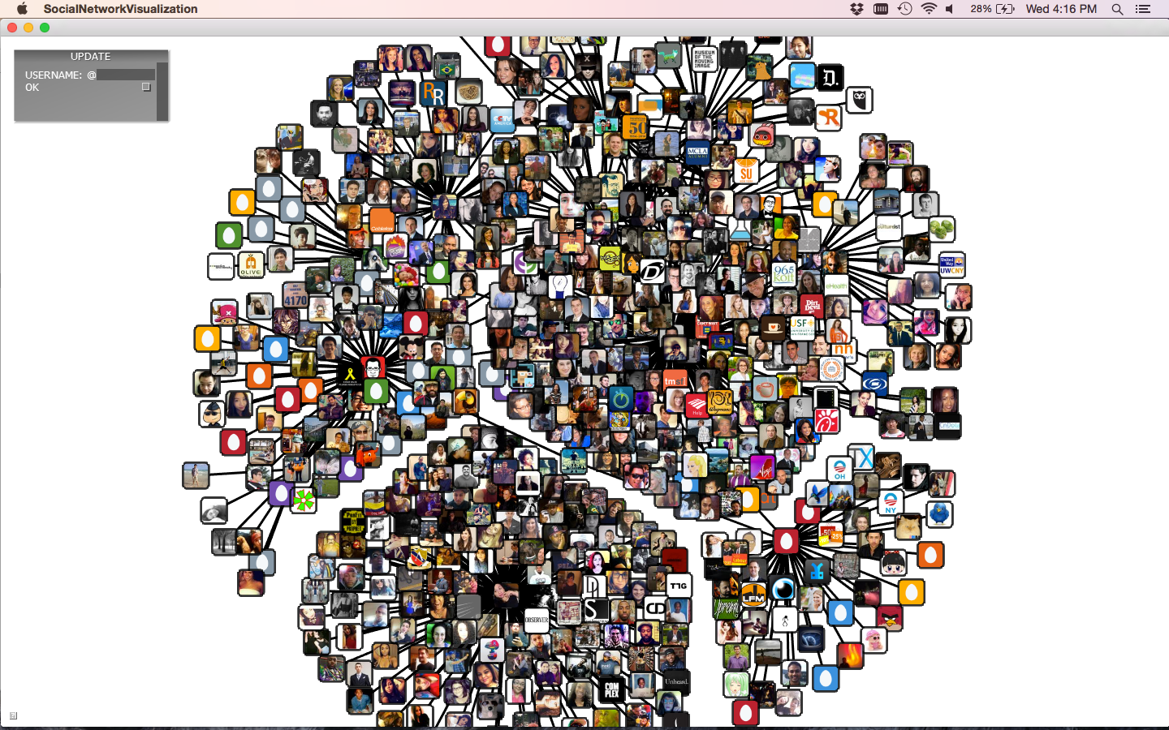

Slide 8
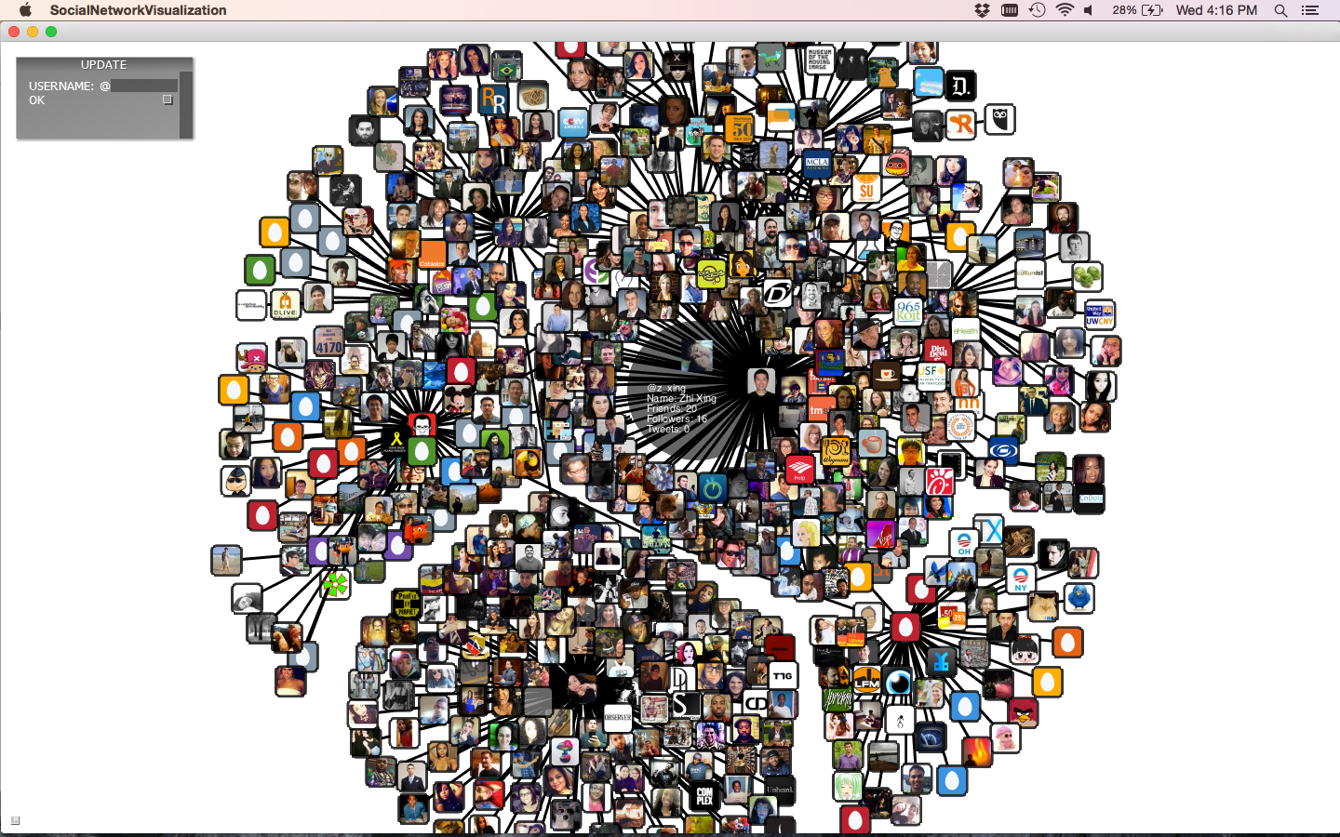

Slide 9
Accomplishments
The displayed graph looks very cool - profile pictures and information
The software interactively creates Twitter social network graph starting from a focused user - want to test Six Degree of Separation?
The GUI is really interactive/responsive even when there’re thousands of nodes - distributed crawlers - Redis database as data buffer and permanent storage - multithreading and memory-caching
Simulated physics “automatically” clusters the nodes - repulsion, attraction, resistance, gravity and more!

Slide 10
Crawler 1
Crawler 2

Slide 11
Distributed crawlers
Run the same python script
Keep checking Redis for requests
Get the neighbors of the requested user, and send everything to Redis
Use different OAuth authorizations
Can be added or removed at runtime
Allow parallel updates of different users and circumvention of rate limit

Slide 12
Communication channel
update@request <list> - cinder pushes usernames - crawlers pops them
update@reply <list> - crawler pushes usernames - cinder pops them
list@username <list> - adjacency lists - crawlers write - cinder reads
info@username <hashmap> - user profile - crawlers write - cinder reads
update@request
update@reply
Crawler
list@username
info@username

Slide 13
Cinder framework & our implementation
App
AppNative / AppBasic
SocialNetworkVisualization

Slide 14
App
InterfaceGl
redisContext
AppNative / AppBasic
SocialNetworkVisualization
ParticleSystem
Particle

Slide 15
App
InterfaceGl
redisContext
AppNative / AppBasic
SocialNetworkVisualization
ParticleSystem
Color
Texture
Particle
Vec2

Slide 16
prepareSettings()
setup()
EventHandlers
update()
draw()
shutdown()

Slide 17
parse arguments
create textbox
connect to Redis
send update request for the focused account to Redis
prepareSettings()
setup()
EventHandlers
update()
draw()
shutdown()

Slide 18
prepareSettings()
mouseDown()
choose an appropriate particle basing on mouse positions
mark the chosen particle
setup()
mouseUp()
unmark the chosen particle
EventHandlers
keyDown()
get the username from the selected particle
send update request for that username to Redis
update()
draw()
shutdown()

Slide 19
prepareSettings()
get update replies from Redis and create particles for new accounts
calculate physics
call update on individual particles (which update their attributes, physics, and positions)
setup()
EventHandlers
update()
draw()
shutdown()

Slide 20
prepareSettings()
setup()
EventHandlers
draw connections between particles
call draw on individual particles
draw textbox
update()
draw()
shutdown()

Slide 21
is image in memory?
Particle::draw()
yes
no
draw image
is image downloaded?
yes
no
load image to memory
put a download request into blocking queue
draw image
draw a grey background in the frame

Slide 22
Set Up
Particle System
Particles —> Map<key=Name, value=Particle>
Edges —> Vector<(Particle, Particle)>
Define default distance of edges
Assign initial coordinates for each particle
particle will be evenly surrounded by its neighbor particles.
Particle
radius; (the size of the particle)
position (current & previous);
color;
force;
mass;

Slide 23
Update
In order to animate our particle system, we need to update position of each particle according to physics principle.
Each particle has:
Repulsion Force; (Particle to Particle)
Magnetic; (Edge between particle)
Resistance Force; (Proportional to particle velocity but opposite direction)
Centripetal Force; (Proportional to particle and center of screen and lways points to the center)
P2
Resistance Force
Centripetal Force
P1
Magnetic From P2
Repulsion From P2
Velocity Direction

Slide 24
Pseudo Code for updating the particles:
update() {
if two particles run into each other:
stop calculating force for this pair of particles
else:
calculate repulsion force for this pair of particles (P1,P2), according to equations ( In terms of particle P1 )
Repulsion_Force = Repulsion_Force_Vector * Repulsion_Coefficient;
Repulsion_Coefficient=(current_distance-2*default_distance)*constant*current_distance* mass;
Repulsion_Force_Vector= Position_of_P1 - Position_of_P2;
calculate magnetic force between each particle pair, according to equation
Magnetic_Force=Velocity_Direction_Vector * (actual_distance-default_distance)
update each particle based on the final force
}
P2
Resistance Force
Centripetal Force
P1
Magnetic From P2
Repulsion From P2
Velocity Direction

Slide 25
Pseudo Code for updating the particles:
particle.update(){
if (current_particle is selected){
increase mass of particle;
}else {
use default mass;
}
calculate velocity as below:
velocity= (particle_current_position - particle_previous_position) * decay_coefficient
Note: decay_coefficient ensures that the particle will not pass its balance point while being updated
calculate centripetal force:
centripetal_force=gravity_direction_vector * gravity_coefficient * distance_to_screen_center
centripetal_direction_vector=particle_current_position - screen_center
Sum up all computed force to get Final Force;
Update current position of the particle as below:
particle_current_position += velocity+ final_force / mass;
}
P2
Resistance Force
Centripetal Force
P1
Magnetic From P2
Repulsion From P2
Velocity Direction

Slide 26
Rendering
Graphic in Cinder is rendered by using OpenGL
Cinder provides good package for OpenGL functions
automatically set up OpenGL context
automatically apply texture image to mesh or shape contour
gl::draw() does them all
Can use customized shader (GLSL) to render advanced image
OpenGL Context
Draw Particle As Rectangle
Texture not Ready
Reset OpenGL Canvas Background
Render Edges
Texture is Ready
Apply Texture to Particle Shape
Particle is selected
Draw Full Info

Slide 27
Rendering
Draw shapes in Cinder
gl::drawSolidRect();
gl::drawStrokedRoundedRect, etc.
Draw texture in Cinder
gl::draw(image, top_left_corner, bot_right_corner);
Draw text in Cinder
gl::TextureFontRef text;
text.drawStringWrapped();
If render purely with OpenGL, developers have to much more code to achieve similar result.
E.g. While drawing rectangle, user has to specify 4 different vertexes and then connect them with straight line in correct order.
@user_name: DO
Followers: 20
Friends: 20
Tweets: 100

Slide 28
Conclusion
Cinder is very easy to use
nicely packed built-in OpenGL library
automatically generate templet for creative coding
automatically does rendering context set up
Redis is a very good data buffer
support multi-language
acting as communication channel between different program components, which can be written by different languages
can retrieve and store data in different format

Slide 29
Conclusion
Difficulties
Stabilizing physics simulation
particles can pass their balance point
Slow rendering speed
need to download to many images
loading images as texture is slow
Finding way out & Surprises
using memory caching to reduce the slowing image loading speed
using multithreading to concurrently download images
add resistance force, velocity decaying method and centripetal force to stabilize physics simulation
our program, which can only render at most 200 particles before, now can render thousands particles.
the simulation is stable, and all the particles intends to get stuck into a location eventually

Slide 30
Thank you.

Slide 31
Q & A

